Slide 1




Bigger Then Data (BTD)
Abdullah Alhuwaishel
Mahmoud Alhassan
Jumana Almussa
Amjad Almusallam
Afnan Alzahrani

Slide 2

Contents
Vision 2030
About Stc & Stc-tv
Data Review
Business problem
EDA
Approach
MapReduce Process
Implementation
Ruselt
Future work

Slide 3

One of the programs of the 2030 vision (Quality of Life) which focus on improving the quality of life for the people & families.

Slide 4

One of the Saudi digital companies who contribute on in improving the life of the individual & families is STC.

Slide 5

STC TV is an entertainment streaming service that provide you with the best movies, tv shows, documentaries, kids shows & more.

Slide 6
Data Review
STC website provides the STC-TV dataset that was used in this case study.
It consists of 13 columns and 1048576 rows
Columns:
User_id_maped ,Date, Program_name, Duration_seconds, Program_class, Season, Episode, Program_desc, Preogram genre, Series_title, HD, Original_name, Ratings

Slide 7
Business problem

Slide 8
EDA

Slide 9
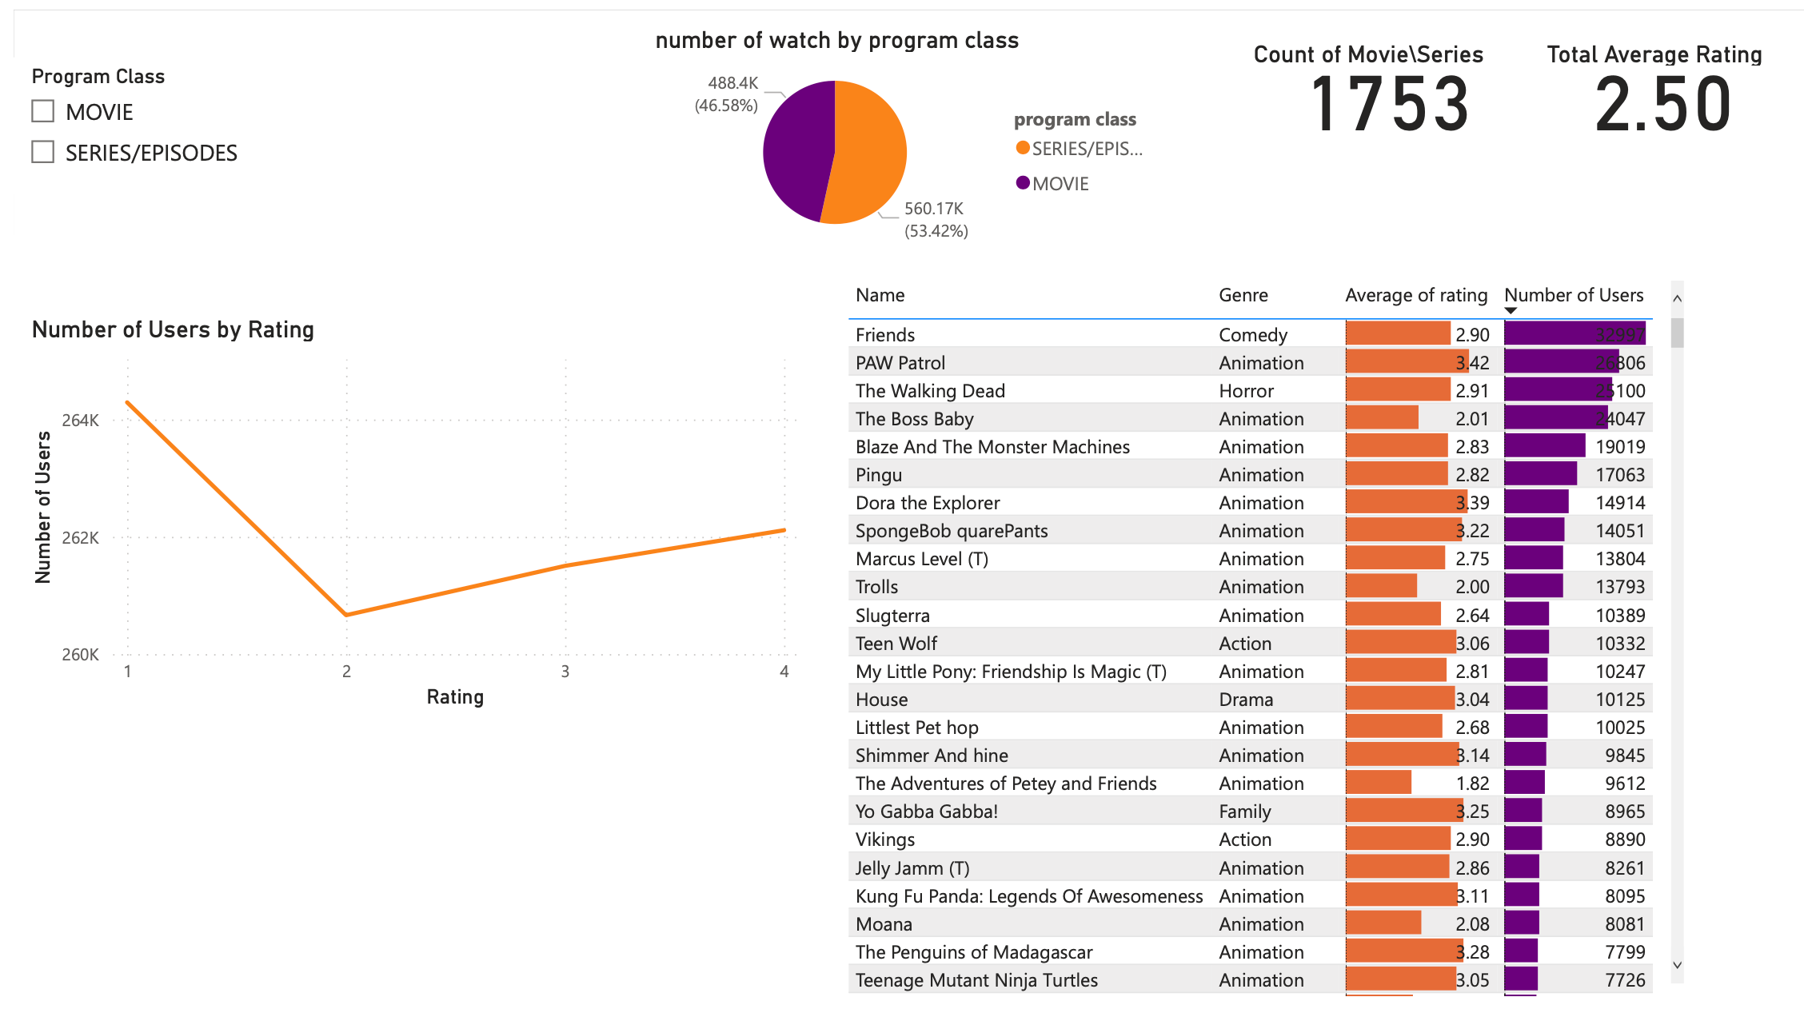

Slide 10
Approach

Slide 11
MapReduce Process
Hadoop MapReduce processes the massive amount of structured and unstructured data stored in HDFS.

Slide 12
How MapReduce works

Slide 13
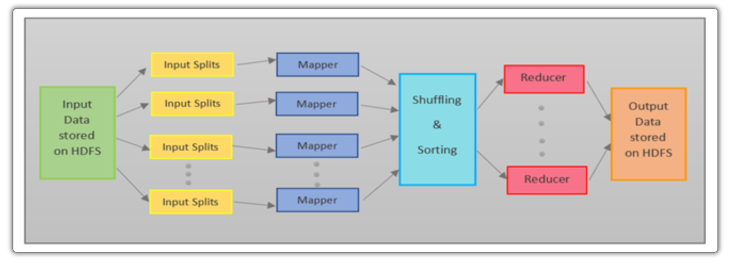

Slide 14
Implementation

Slide 15
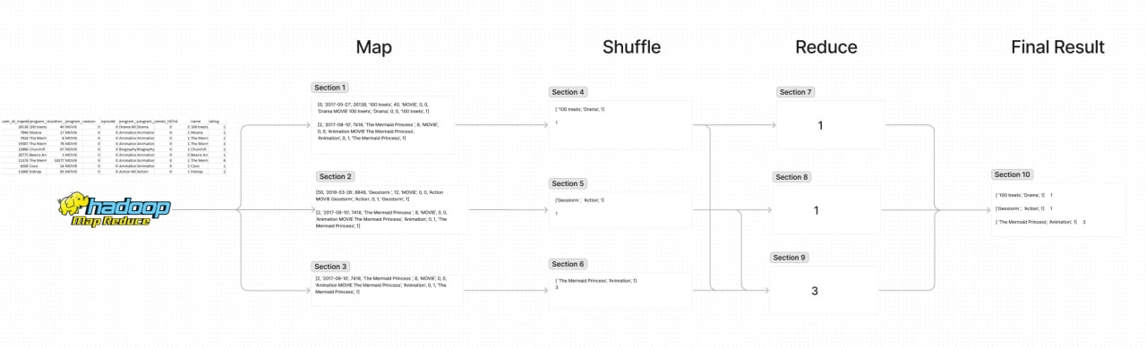

Slide 16
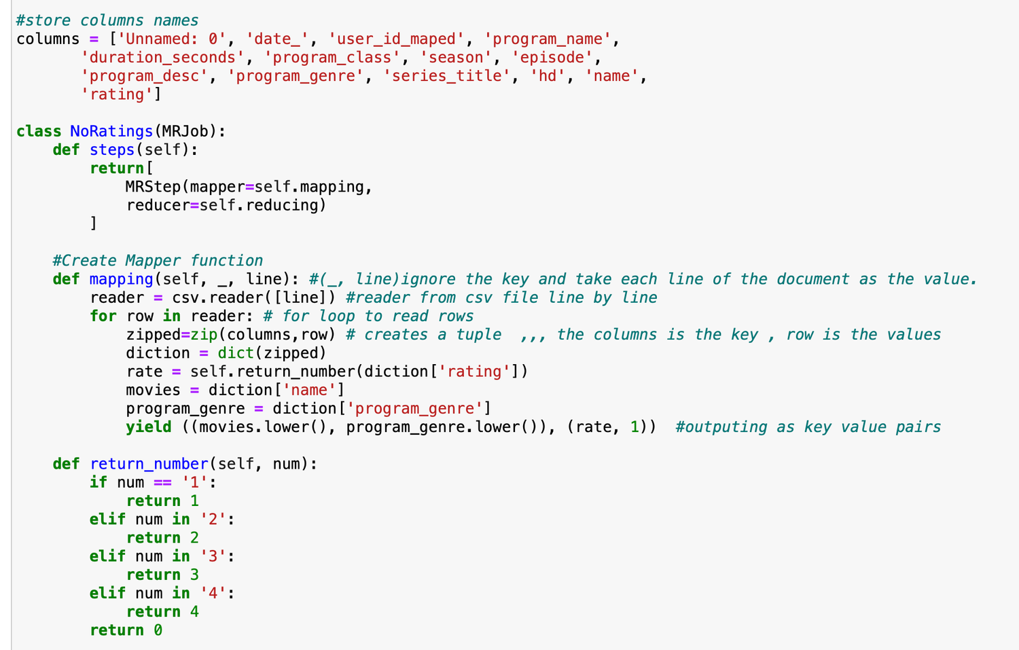

Slide 17
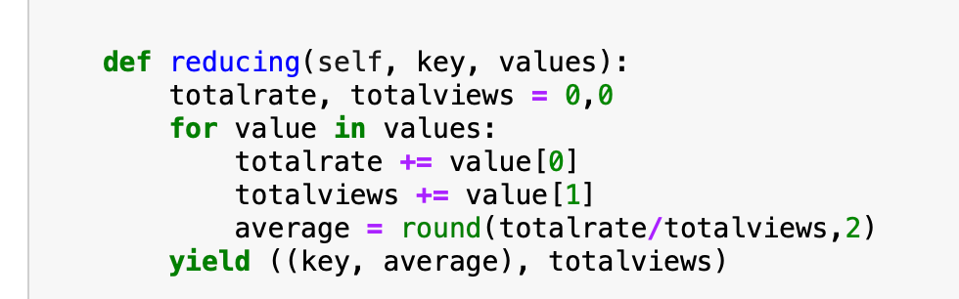

Slide 18
Ruselt

Slide 19
Future work

Slide 20
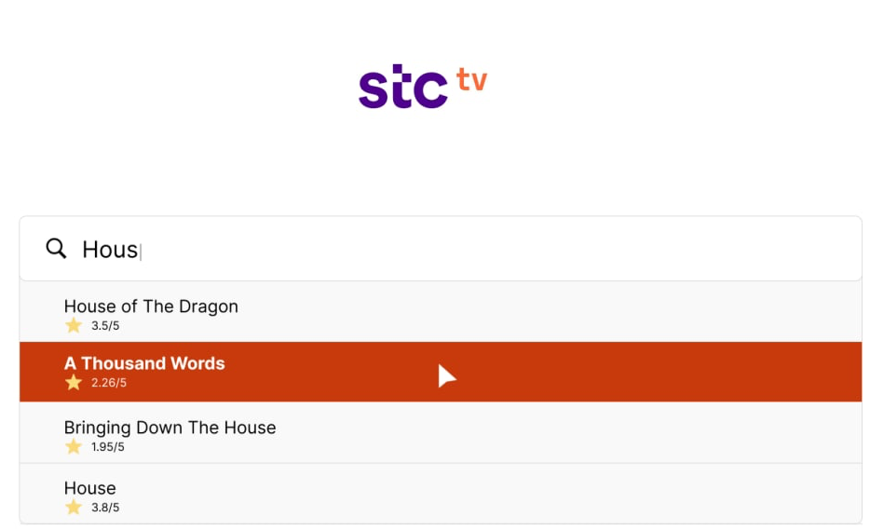

Slide 21

Thank you!

